Slide 1
Module 6
DIGITAL ELECTRONICS

Slide 2
DIGITAL ELECTRONICS
In analog system, the output can be continuously controlled by the input & the output is linearly proportional to the input. In digital system, the digital logic used only two values, either HIGH or LOW. i.e. they have only two discrete values and are called BINARY. The binary may be either logic 0 or logic ‘1’. A logic value of ‘0’ or ‘1’ is often called as BINARY DIGIT or BIT.
Department of Electronics and Communication Engineering,
Manipal Institute of Technology, Manipal, INDIA

Slide 3
Number System
Number System: Many number systems are used in digital technology. Most common are binary, decimal, octal & hexadecimal system.
Binary Number system: A number system that uses only two digits ‘0’&’1’ is called binary number system. The binary number system is also called as Base 2 system or Radix 2 system.
Examples: (100010)₂
(0.1011)₂
Department of Electronics and Communication Engineering,
Manipal Institute of Technology, Manipal, INDIA

Slide 4
Convert the given binary number into decimal equivalent number
1. (100010)₂=0×2⁰+1×2¹+0×2²+0×2³+0×2⁴+1×2⁵
=0+2+0+0+0+32
=(34)₁₀
2. (0.1011)₂=1×2⁻¹+0×2⁻²+1×2⁻³+1×2⁻⁴
=0.5+0+0.125+0.0625
=(0.6875)₁₀
Department of Electronics and Communication Engineering,
Manipal Institute of Technology, Manipal, INDIA

Slide 5
3. (10101.011)₂
Integer part: (10101)₂=1×2⁰+0×2¹+1×2²+0×2³+1×2⁴
=1+0+4+0+16 = (21)₁₀
Decimal part: (0.011)₂ =0×2⁻¹+1×2⁻²+1×2⁻³
= (0.375)₁₀
= (21.375)₁₀
Department of Electronics and Communication Engineering,
Manipal Institute of Technology, Manipal, INDIA

Slide 6
Octal Numbers | Binary Equivalent number
 | 4 2 1 (weights)
0 | 0 0 0
1 | 0 0 1
2 | 0 1 0
3 | 0 1 1
4 | 1 0 0
5 | 1 0 1
6 | 1 1 0
7 | 1 1 1
Octal Number System: A number system that uses 8 digit (0-7) is called an octal number system. It has base 8.
Example: (723)₈, (676)₈
Department of Electronics and Communication Engineering,
Manipal Institute of Technology, Manipal, INDIA

Slide 7
Hexadecimal number system | Equivalent binary number
 | 8 4 2 1 (weights)
0 | 0 0 0 0
1 | 0 0 0 1
2 | 0 0 1 0
3 | 0 0 1 1
4 | 0 1 0 0
5 | 0 1 0 1
6 | 0 1 1 0
7 | 0 1 1 1
8 | 1 0 0 0
9 | 1 0 0 1
10 | 1 0 1 0 = A
11 | 1 0 1 1 = B
12 | 1 1 0 0 = C
13 | 1 1 0 1 = D
14 | 1 1 1 0 = E
15 | 1 1 1 1 = F
Hexadecimal Number System:
The hexadecimal number system has base 16. It has 16 distinct digit symbols. It uses the digits 0-9 & letters A,B,C,D,E,F as 16 digit symbols.
Department of Electronics and Communication Engineering,
Manipal Institute of Technology, Manipal, INDIA

Slide 8

Convert the following octal number into decimal number system
1. (2376)₈ = (?)₁₀
= 2×8³+3×8²+7×8¹+6×8⁰
= 1024+192+56+6
= (1278)₁₀
2. (1234.567)₈=1×8³+2×8²+3×8¹+4×8⁰
+5×8⁻¹+6×8⁻²+7×8⁻³
=512+128+24+4+0.625+0.09375+0.01367
= (668.7324219)₁₀
Department of Electronics and Communication Engineering,
Manipal Institute of Technology, Manipal, INDIA

Slide 9
Convert the following hexadecimal number into decimal number system
1. (269)₁₆=2×16²+6×16¹+9×16⁰
= 2×256+96+9
= (617)₁₀
2. (2B8D.E2)16=2×16³+11×16²+8×16¹+13×16⁰ +14×16⁻¹+2×16⁻²
= 8192+2816+128+13+0.875+0.0078125
= (11149.88281)₁₀
Department of Electronics and Communication Engineering,
Manipal Institute of Technology, Manipal, INDIA

Slide 10
Conversion form Decimal number system to Binary number system:
*The given decimal number (integer) is repeatedly divided by 2, which is the base number of binary system till quotient becomes ‘0’ and collect the remainder from bottom to top.
*To convert the fractional part into binary, multiply fraction by 2 repeatedly, record any carry in integer place. The string of integer obtained from top to bottom gives the equivalent fraction in binary number system.
Department of Electronics and Communication Engineering,
Manipal Institute of Technology, Manipal, INDIA

Slide 11
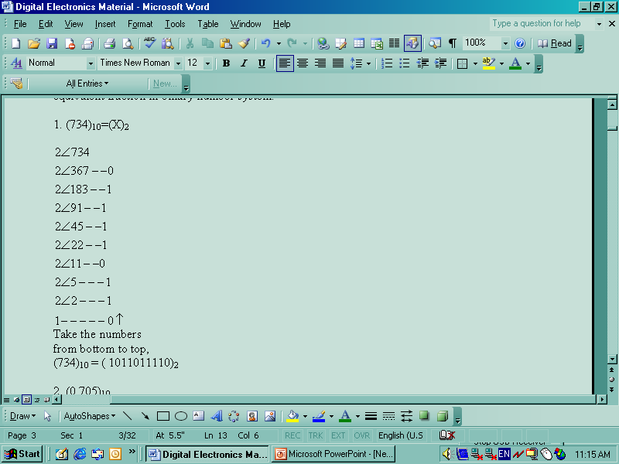
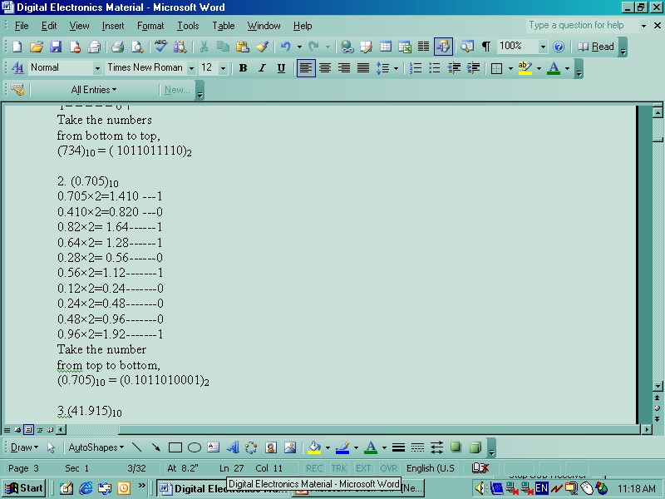
Department of Electronics and Communication Engineering,
Manipal Institute of Technology, Manipal, INDIA

Slide 12
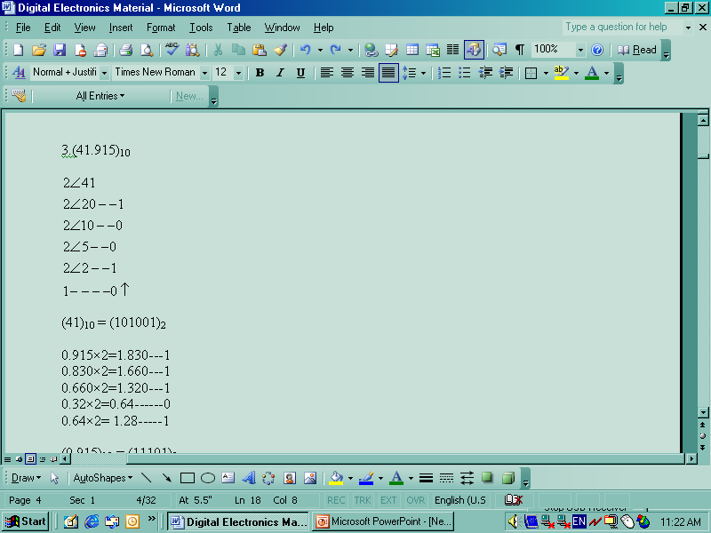
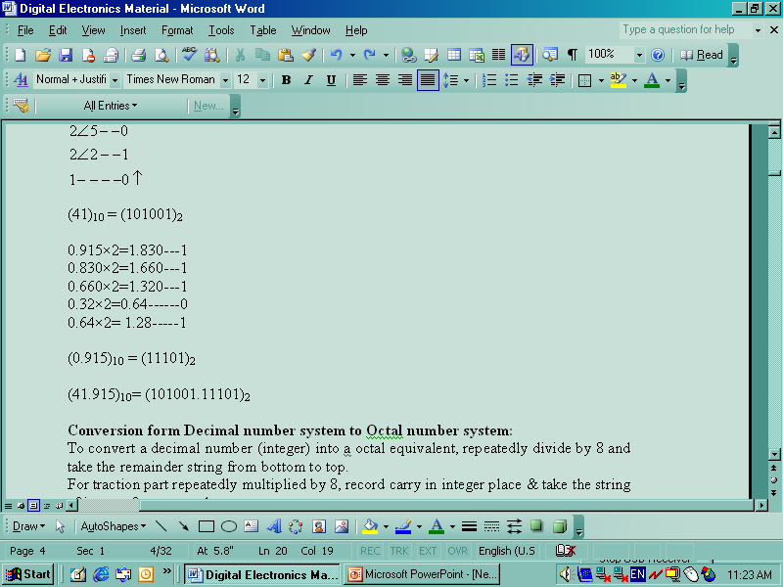
Department of Electronics and Communication Engineering,
Manipal Institute of Technology, Manipal, INDIA

Slide 13
Conversion form Decimal number system to Octal number system:
To convert a decimal number (integer) into octal equivalent, repeatedly divide by 8 and take the remainder string from bottom to top.
For fraction part repeatedly multiply by 8, record carry in integer place & take the string of integer from top to bottom.
Department of Electronics and Communication Engineering,
Manipal Institute of Technology, Manipal, INDIA

Slide 14
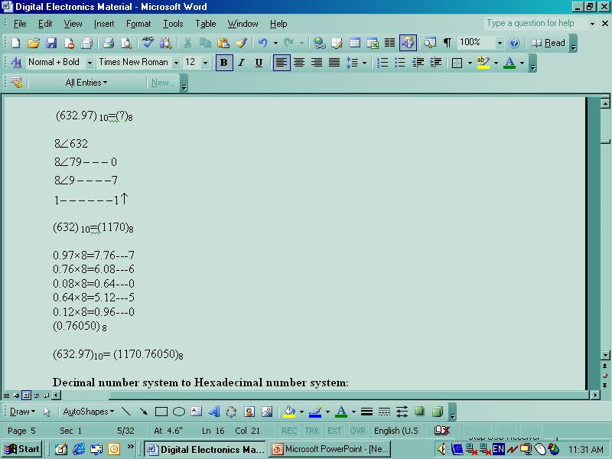
Department of Electronics and Communication Engineering,
Manipal Institute of Technology, Manipal, INDIA

Slide 15
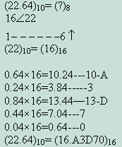
Decimal number system to Hexadecimal number system:
To convert a decimal number (integer) into a hexadecimal equivalent, repeatedly divide by 16 and take the remainder string from bottom to top.
For traction part repeatedly multiplied by 16, record carry in integer place & take the string of integer from top to bottom.
Department of Electronics and Communication Engineering,
Manipal Institute of Technology, Manipal, INDIA

Slide 16
Conversion from Octal number system into Binary number system:
When an octal number is to be converted to its equivalent binary number, each of its digits is replaced by equivalent group of three binary digits.
(7423.245)₈
7 | 4 | 2 | 3 | . | 2 | 4 | 5
111 | 100 | 010 | 011 | . | 010 | 100 | 101
(7423.245)₈= (111100010011.010100101)₂
Department of Electronics and Communication Engineering,
Manipal Institute of Technology, Manipal, INDIA

Slide 17
Conversion from Binary number system to Octal number system:
To convert, Starting from the binary point, the binary digits are arranged in groups of three on both sides. Each in group of binary digit is replaced by its octal equivalent.
Note: 0’s can be added on either side, if needed to complete a group of three.
(11101101110.11111)₂
011 | 101 | 101 | 110 | . | 111 | 110
3 | 5 | 5 | 6 | . | 7 | 6
(11101101110.11111)₂ =(3556.72)₈
Department of Electronics and Communication Engineering,
Manipal Institute of Technology, Manipal, INDIA

Slide 18
Conversion from Hexadecimal number system to Binary number system
When a hexadecimal number is to be converted its equivalent binary number, each of its digits is replaced by equivalent group of 4 binary digits.
(347.28)₁₆
3 | 4 | 7 | . | 2 | 8
0011 | 0100 | 0111 | . | 0010 | 1000
(347.28)₁₆= (001101000111.00101000)₂
Department of Electronics and Communication Engineering,
Manipal Institute of Technology, Manipal, INDIA

Slide 19
Conversion from Binary number system to Hexadecimal number system:
To convert, Starting from the binary point, the binary digits are arranged in groups of four on both sides. Each in group of binary digit is replaced by its hexadecimal equivalent. Note: 0’s can be added on either side, if needed to complete a group of four.
(110111101.01)₂=(?)₁₆
0001 | 1011 | 1101 | . | 0100
1 | B | D | . | 4
(110111101.01)₂=(1BD.4)₁₆
Department of Electronics and Communication Engineering,
Manipal Institute of Technology, Manipal, INDIA

Slide 20
Conversion from Octal number system to Hexadecimal number system:
Write down the three bit binary equivalent of octal digit and then rearranging into group of four bits with ‘0’s added on either side of decimal point, if needed to complete the group of four.
(46) ₈ = (?)₁₆
Octal equivalent | 4 6 100 110
Hexadecimal equivalent | 0010 0110 2 6
(46) ₈ = (26)₁₆
Department of Electronics and Communication Engineering,
Manipal Institute of Technology, Manipal, INDIA

Slide 21
Conversion from Hexadecimal number system to Octal number system:
First write down the 4 bit binary equivalent of hexadecimal digit and then rearranging into group of three bit each.
(2AB.9) ₁₆ = (?)₈
Hexadecimal equivalent | 2 A B . 9 0010 1010 1011 . 1001
Octal equivalent | 001 010 101 011 . 100 100 1 2 5 3 . 4 4
(2AB.9) ₁₆ = (1253.44)₈
Department of Electronics and Communication Engineering,
Manipal Institute of Technology, Manipal, INDIA

Slide 22
Represent the (743.6)₁₀ in BCD
7 | 4 | 3 | . | 6
0111 | 0100 | 0011 | . | 0110
(743.6)₁₀=(011101000011.0110) _{BCD}
Convert the following BCD into Decimal:
11011100001001
0011 | 0111 | 0000 | 1001
3 | 7 | 0 | 9
(11011100001001) _{BCD}=(3709)₁₀
Department of Electronics and Communication Engineering,
Manipal Institute of Technology, Manipal, INDIA

Slide 23
Binary Addition: The rules adopted for binary additions are
0 |  | 0 |  | 1 |  | 1
+0 |  | +1 |  | +0 |  | +1
C=0 | S=0 | C=0 | S=1 | C=0 | S=1 | C=1 | S=0
The sum of two 1’s gives binary ‘10’ i.e.2, there is a carry. The carry is taken to the next higher column.
Example : (1010)₂+(0111)₂
1010 =10
+0111 =7
10001 =17
(1010)₂+(0111)₂=(10001)₂
Department of Electronics and Communication Engineering,
Manipal Institute of Technology, Manipal, INDIA

Slide 24
1’s complement subtraction:
Step1: Add minuend to the 1’s complement of the subtrahend.
Step2: Inspect the result obtained in step1 for an end carry. (a) If an end carry occurs, add 1 to the least significant bit. (end round carry) (b) If an end carry doesn’t occur, take 1’s complement of the number obtained in step1 and place a negative sign in front of it.
Example; ( 1000)₂ from (1101)₂
1101—minuend
1000— subtrahend
1’s complement of subtrahend = 0111
Add minuend and 1’s complement of subtrahend,
Department of Electronics and Communication Engineering,
Manipal Institute of Technology, Manipal, INDIA

Slide 25
 | 1 | 1 | 0 | 1
+ | 0 | 1 | 1 | 1
1 | 0 | 1 | 0 | 0
End carry | Add to LSB |  |  | +1
 | 0 | 1 | 0 | 1
(1101)₂ - ( 1000)₂= (0101)₂
Department of Electronics and Communication Engineering,
Manipal Institute of Technology, Manipal, INDIA

Slide 26
Example (6)₁₀-(14)₁₀
6=0110—minuend
14=1110— subtrahend
1’s complement of subtrahend = 0001
Add minuend and 1’s complement of subtrahend,
 | 0 | 1 | 1 | 0
+ | 0 | 0 | 0 | 1
No End carry | 0 | 1 | 1 | 1
Take 1’s complement of the 0111 & place negative sign in front of it =-1000
(0110)₂ - ( 1110)₂= -(1000)₂
Department of Electronics and Communication Engineering,
Manipal Institute of Technology, Manipal, INDIA

Slide 27
2’s complement:
To find the 2’s form of any binary number, obtain the 1’s complement of the given number and then add ‘1’ to the LSB.
(100100)2
Take 1’s complement of the number = 011011
Add ‘1’ to LSB to get 2’s complement = 011011
+1
011100
2’s complement = (011100)₂
Department of Electronics and Communication Engineering,
Manipal Institute of Technology, Manipal, INDIA

Slide 28
2’s complement subtraction:
Step1: find 2’s complement of subtrahend
Step2: Add minuend and 2’s complement subtrahend
Step3: (a) If an end carry occurs, discard it. (b) If an end carry doesn’t occur, take 2’s complement of the number obtained in step2 and place a negative sign in front of it.
Department of Electronics and Communication Engineering,
Manipal Institute of Technology, Manipal, INDIA

Slide 29
Example 1. (1111)₂-(1100)₂
1111—minuend
1100— subtrahend
2’s complement of subtrahend = 0100
Add minuend and 2’s complement of subtrahend,
 | 1 | 1 | 1 | 1
+ | 0 | 1 | 0 | 0
1 Neglect end carry | 0 | 0 | 1 | 1
(1111)₂-(1100)₂=(0011)₂
Department of Electronics and Communication Engineering,
Manipal Institute of Technology, Manipal, INDIA

Slide 30
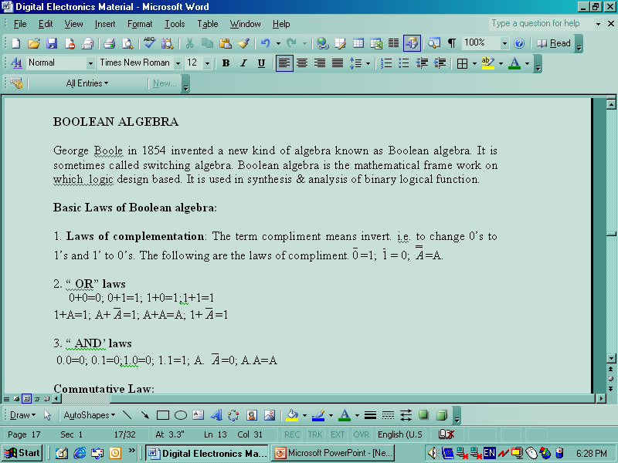
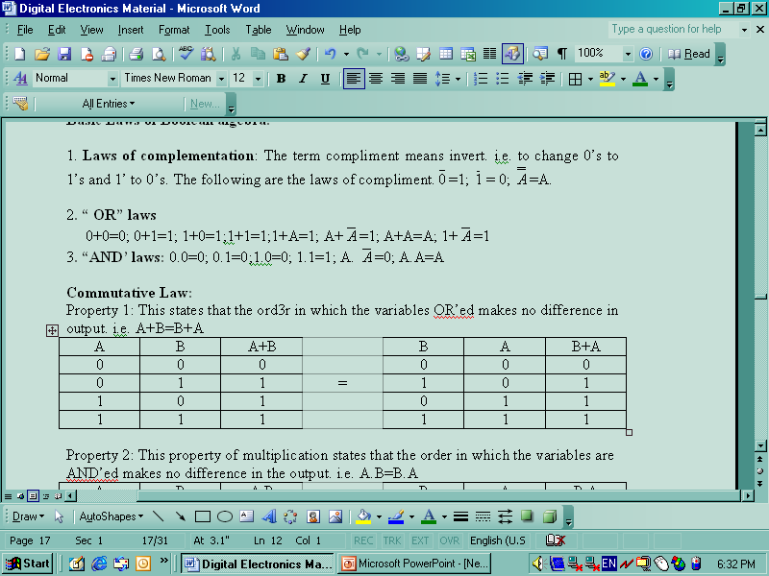
BOOLEAN ALGEBRA
George Boole in 1854 invented a new kind of algebra known as Boolean algebra. It is sometimes called switching algebra. Boolean algebra is the mathematical frame work on which logic design based. It is used in synthesis & analysis of binary logical function.
Basic Laws of Boolean algebra:
1. Laws of complementation: The term compliment means invert. i.e. to change 0’s to 1’s and 1’ to 0’s. The following are the laws of compliment
Department of Electronics and Communication Engineering,
Manipal Institute of Technology, Manipal, INDIA

Slide 31
Commutative Law:
Property 1 : A+B=B+A
A | B | A+B |  | B | A | B+A
0 | 0 | 0 |  | 0 | 0 | 0
0 | 1 | 1 | = | 1 | 0 | 1
1 | 0 | 1 |  | 0 | 1 | 1
1 | 1 | 1 |  | 1 | 1 | 1
Department of Electronics and Communication Engineering,
Manipal Institute of Technology, Manipal, INDIA

Slide 32
Property 2: This property of multiplication states that the order in which the variables are AND’ed makes no difference in the output. i.e. A.B=B.A
A | B | A.B |  | B | A | B.A
0 | 0 | 0 |  | 0 | 0 | 0
0 | 1 | 0 | = | 1 | 0 | 0
1 | 0 | 0 |  | 0 | 1 | 0
1 | 1 | 1 |  | 1 | 1 | 1
Department of Electronics and Communication Engineering,
Manipal Institute of Technology, Manipal, INDIA

Slide 33
Associative property:
Property1: This property states that in the OR’ing of the several variables, the result is same regardless of grouping of variables. For three variables i.e.(A OR’ed with B)or’ed with C is same as A OR’ed with (B OR’ed with C)
i.e. (A+B)+C = A+(B+C)
A | B | C | A+B | B+C | (A+B)+C |  | A+(B+C)
0 | 0 | 0 | 0 | 0 | 0 |  | 0
0 | 0 | 1 | 0 | 1 | 1 |  | 1
0 | 1 | 0 | 1 | 1 | 1 |  | 1
0 | 1 | 1 | 1 | 1 | 1 | = | 1
1 | 0 | 0 | 1 | 0 | 1 |  | 1
1 | 0 | 1 | 1 | 1 | 1 |  | 1
1 | 1 | 0 | 1 | 1 | 1 |  | 1
1 | 1 | 1 | 1 | 1 | 1 |  | 1
Department of Electronics and Communication Engineering,
Manipal Institute of Technology, Manipal, INDIA

Slide 34
Property2: The associative property of multiplication states that, it makes no difference in what order the variables are grouped when AND ’ing several variables. (A.B)C = A(B.C)
A | B | C | A.B | B.C | (A.B)C |  | A(B.C)
0 | 0 | 0 | 0 | 0 | 0 |  | 0
0 | 0 | 1 | 0 | 0 | 0 |  | 0
0 | 1 | 0 | 0 | 0 | 0 |  | 0
0 | 1 | 1 | 0 | 1 | 0 | = | 0
1 | 0 | 0 | 0 | 0 | 0 |  | 0
1 | 0 | 1 | 0 | 0 | 0 |  | 0
1 | 1 | 0 | 1 | 0 | 0 |  | 0
1 | 1 | 1 | 1 | 1 | 1 |  | 1
Department of Electronics and Communication Engineering,
Manipal Institute of Technology, Manipal, INDIA

Slide 35
Distributive property:
Property 1: A(B+C) = A.B + A.C
1 | 2 | 3 | 4 | 5 | 6 | 7 | 8
A | B | C | B+C | A(B+C) | A.B | A.C | A.B+A.C
0 | 0 | 0 | 0 | 0 | 0 | 0 | 0
0 | 0 | 1 | 1 | 0 | 0 | 0 | 0
0 | 1 | 0 | 1 | 0 | 0 | 0 | 0
0 | 1 | 1 | 1 | 0 | 0 | 0 | 0
1 | 0 | 0 | 0 | 0 | 0 | 0 | 0
1 | 0 | 1 | 1 | 1 | 0 | 1 | 1
1 | 1 | 0 | 1 | 1 | 1 | 0 | 1
1 | 1 | 1 | 1 | 1 | 1 | 1 | 1
Column number 5= Column number 8, hence the proof.
Department of Electronics and Communication Engineering,
Manipal Institute of Technology, Manipal, INDIA

Slide 36
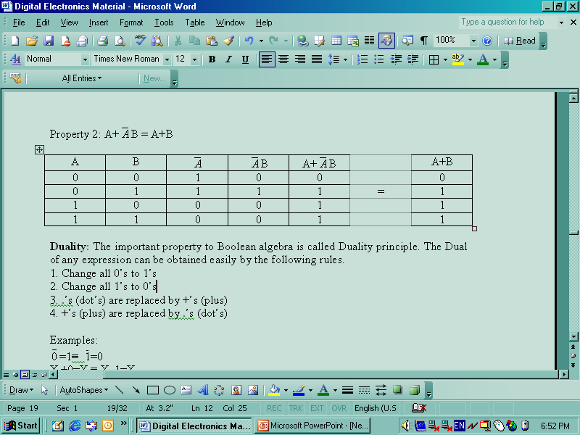
Department of Electronics and Communication Engineering,
Manipal Institute of Technology, Manipal, INDIA

Slide 37
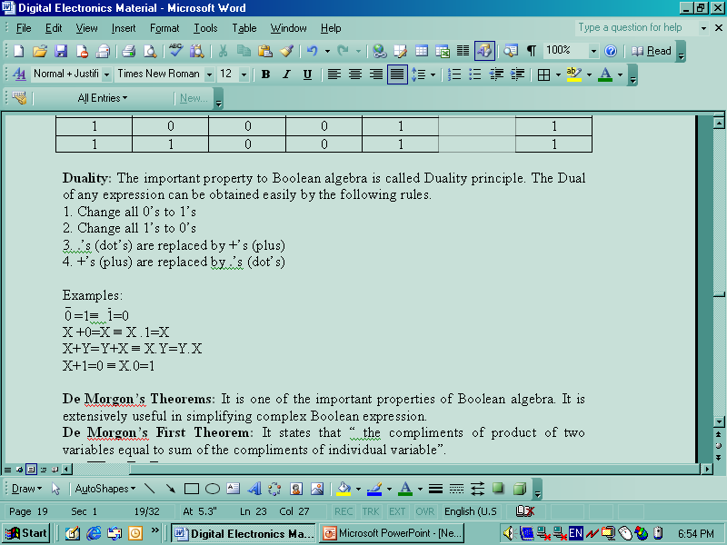
Duality: The important property to Boolean algebra is called Duality principle. The Dual of any expression can be obtained easily by the following rules.
1. Change all 0’s to 1’s
2. Change all 1’s to 0’s
3. .’s (dot’s) are replaced by +’s (plus)
4. +’s (plus) are replaced by .’s (dot’s)
Department of Electronics and Communication Engineering,
Manipal Institute of Technology, Manipal, INDIA

Slide 38
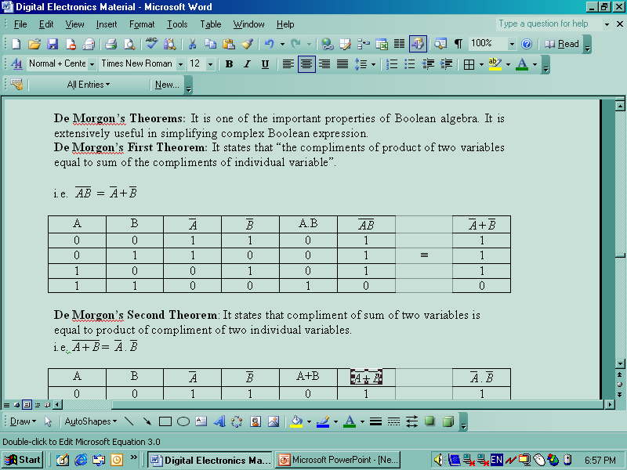
De Morgon’s Theorems: It is one of the important properties of Boolean algebra. It is extensively useful in simplifying complex Boolean expression.
De Morgon’s First Theorem: It states that “the compliments of product of two variables equal to sum of the compliments of individual variable”.
Department of Electronics and Communication Engineering,
Manipal Institute of Technology, Manipal, INDIA

Slide 39
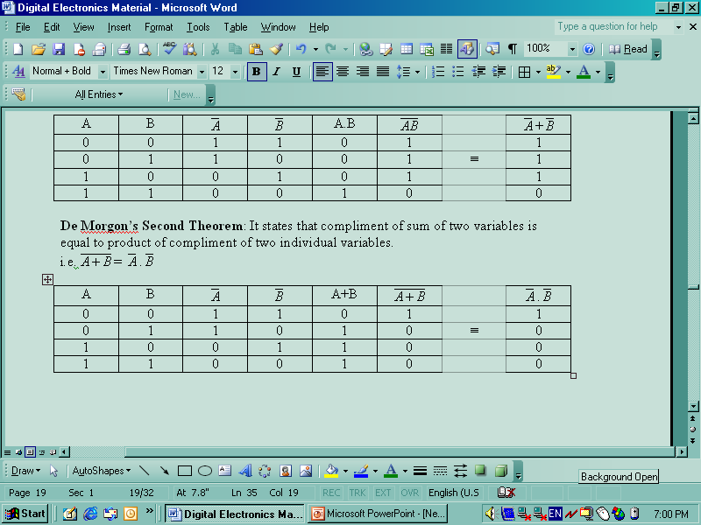
De Morgon’s Second Theorem: It states that compliment of sum of two variables is equal to product of compliment of two individual variables.
Department of Electronics and Communication Engineering,
Manipal Institute of Technology, Manipal, INDIA

Slide 40
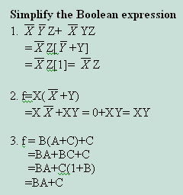
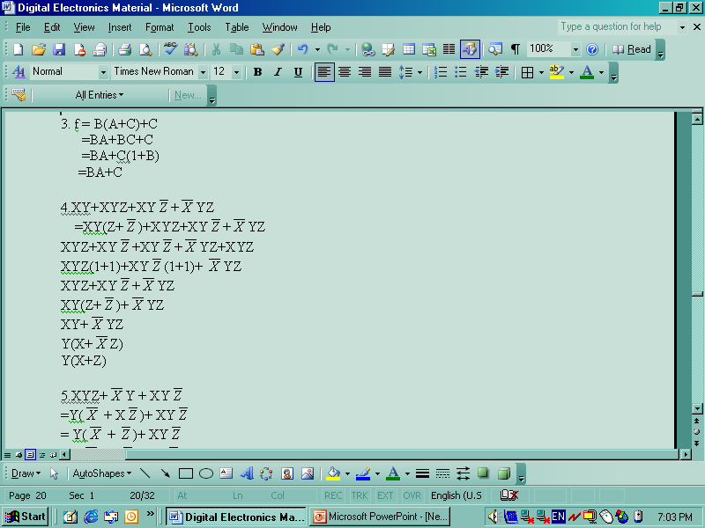
Department of Electronics and Communication Engineering,
Manipal Institute of Technology, Manipal, INDIA

Slide 41
Logic Gates
It is an electronic circuit which makes logic decisions. A logic gate is a digital circuit with one or more input signal and only one output signal. All input or output signals either low voltage or high voltage. A digital circuit is referred to as logic gate for simple reason i.e. it can be analyzed on the basis of Boolean algebra.
To make logical decisions, three gates are used. They are OR, AND and NOT gate. These logic gates are building blocks which are available in the form of IC.
The input and output of the binary variables for each gate can be represented in a tabular column or truth table.
Department of Electronics and Communication Engineering,
Manipal Institute of Technology, Manipal, INDIA

Slide 42
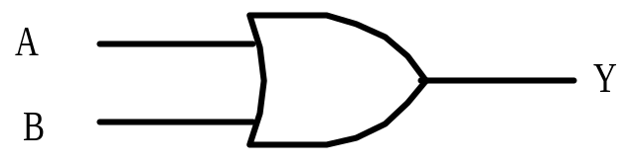
1. OR Gate: The OR gate performs logical additions commonly known as OR function. The OR gate has two or more inputs and only one output. The operation of OR gate is such that a HIGH(1) on the output is produced when any of the input is HIGH. The output is LOW(0) only when all the inputs are LOW.
If A & B are the input variables of an OR gate and c is its output, then A+B. similarly for more than two variables, the OR function can be expressed as Y=A+B+C.
Logical Symbol:
Input |  | Output
A | B | Y= A+B
0 | 0 | 0
0 | 1 | 1
1 | 0 | 1
1 | 1 | 1
Department of Electronics and Communication Engineering,
Manipal Institute of Technology, Manipal, INDIA

Slide 43
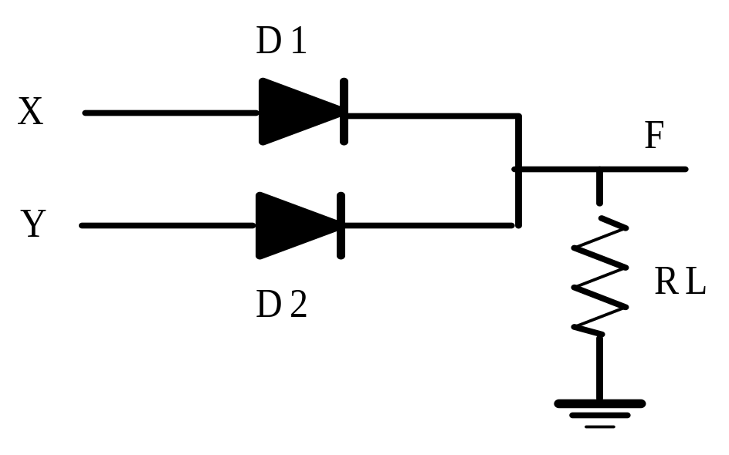
Realization of OR gate using diodes:
Two input OR gate using "diode-resistor" logic is shown in figure below. Where X, Y are the inputs and F is the output.
Department of Electronics and Communication Engineering,
Manipal Institute of Technology, Manipal, INDIA

Slide 44
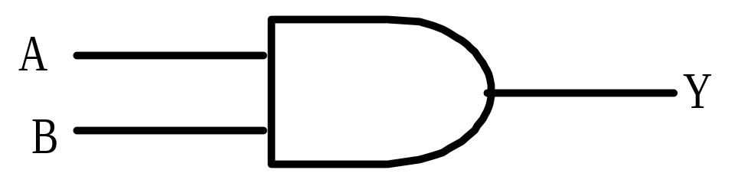
2. AND Gate:The AND gate performs logical multiplication, commonly known as AND function. The AND gate has two or more inputs and a single output. The output of an AND gate is HIGH only when all the inputs are HIGH. Even if any one of the input is LOW, the output will be LOW. If a & b are input variables of an AND gate and c is its output, then Y=A.B
Input |  | Output
A | B | Y=A.B
0 | 0 | 0
0 | 1 | 0
1 | 0 | 0
1 | 1 | 1
Department of Electronics and Communication Engineering,
Manipal Institute of Technology, Manipal, INDIA

Slide 45
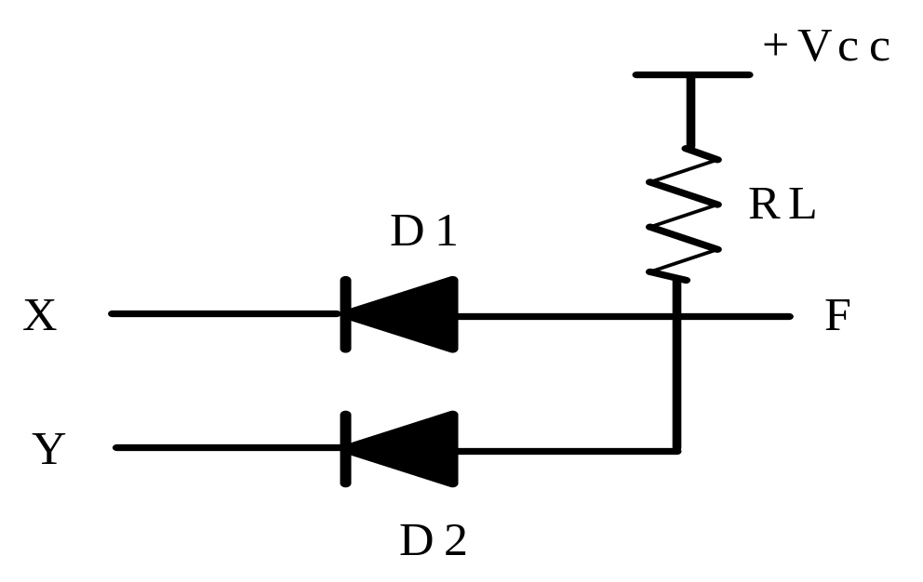
Realization of AND gate using diodes:
Two input AND gate using "diode-resistor" logic is shown in figure below. Where X, Y are inputs and F is the output.
Department of Electronics and Communication Engineering,
Manipal Institute of Technology, Manipal, INDIA

Slide 46
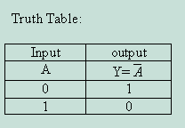
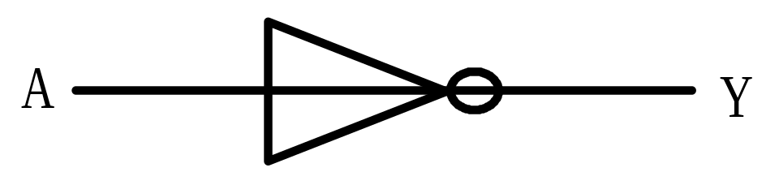
3. Not Gate ( Inverter): The NOT gate performs the basic logical function called inversion or complementation. The purpose of his gate is to convert one logic level into the opposite logic level. It has one input and one output. When a HIGH level is applied to an inverter, a LOW level appears at the output and vice-versa.
Department of Electronics and Communication Engineering,
Manipal Institute of Technology, Manipal, INDIA

Slide 47
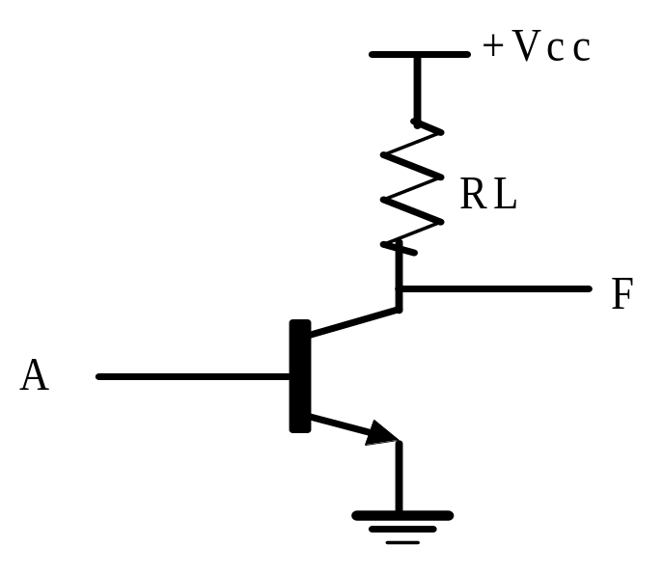
Realization of NOT gate using Transistors:
A NOT gate using a transistor is shown in below figure. ‘A’ represents the input and ‘F’ represents the output. When the input is HIGH, the transistor is in the ON state and the output is LOW. If the input is LOW, the transistor is in the OFF state and the output F is HIGH.
Department of Electronics and Communication Engineering,
Manipal Institute of Technology, Manipal, INDIA

Slide 48
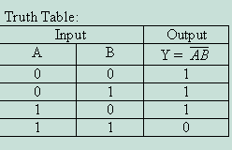
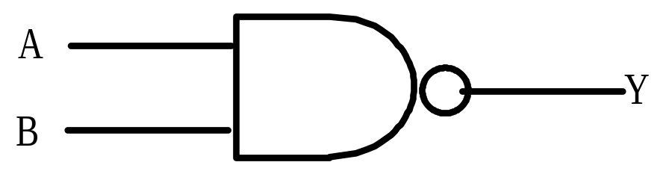
4.NAND Gate: The output of a NAND gate is LOW only when all inputs are HIGH and output of the NAND is HIGH if one or more inputs are LOW.
Department of Electronics and Communication Engineering,
Manipal Institute of Technology, Manipal, INDIA

Slide 49
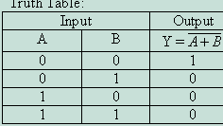
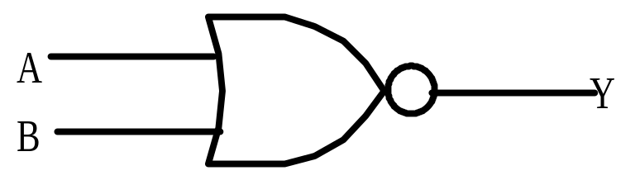
5. NOR Gate: The output of the NOR gate is HIGH only when all the inputs are LOW.
Department of Electronics and Communication Engineering,
Manipal Institute of Technology, Manipal, INDIA

Slide 50
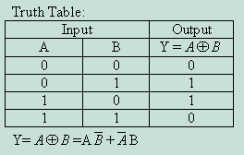
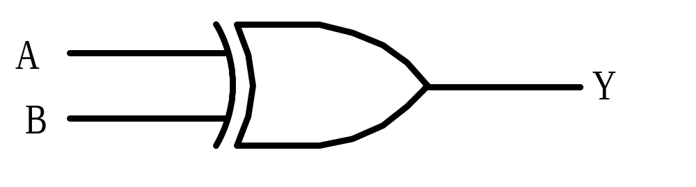
6.XOR Gate or Exclusive OR gate: In this gate output is HIGH only when any one of the input is HIGH. The circuit is also called as inequality comparator, because it produces output when two inputs are different.
Department of Electronics and Communication Engineering,
Manipal Institute of Technology, Manipal, INDIA

Slide 51
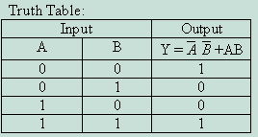
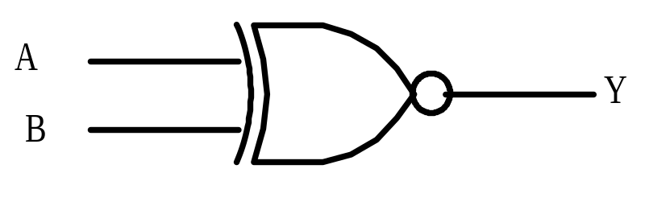
7. XNOR Gate or Exclusive NOR Gate: An XNOR gate is a gate with two or more inputs and one output. XNOR operation is complimentary of XOR operation. i.e. The output of XNOR gate is High, when all the inputs are identical; otherwise it is low.
Department of Electronics and Communication Engineering,
Manipal Institute of Technology, Manipal, INDIA

Slide 52
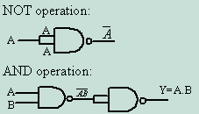
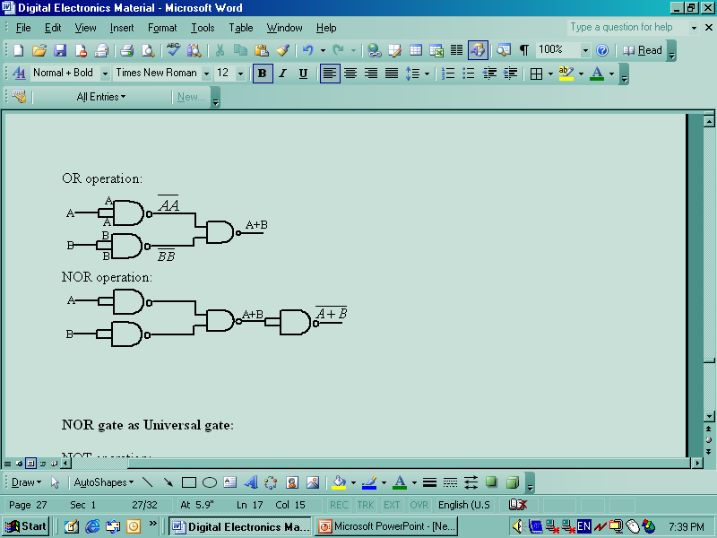
Universal Logic Gate: NAND and NOR gates are called Universal gates or Universal building blocks, because both can be used to implement any gate like AND,OR an NOT gates or any combination of these basic gates.
NAND gate as Universal gate
Department of Electronics and Communication Engineering,
Manipal Institute of Technology, Manipal, INDIA

Slide 53

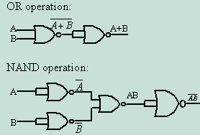
NOR gate as Universal gate:
Department of Electronics and Communication Engineering,
Manipal Institute of Technology, Manipal, INDIA

Slide 54
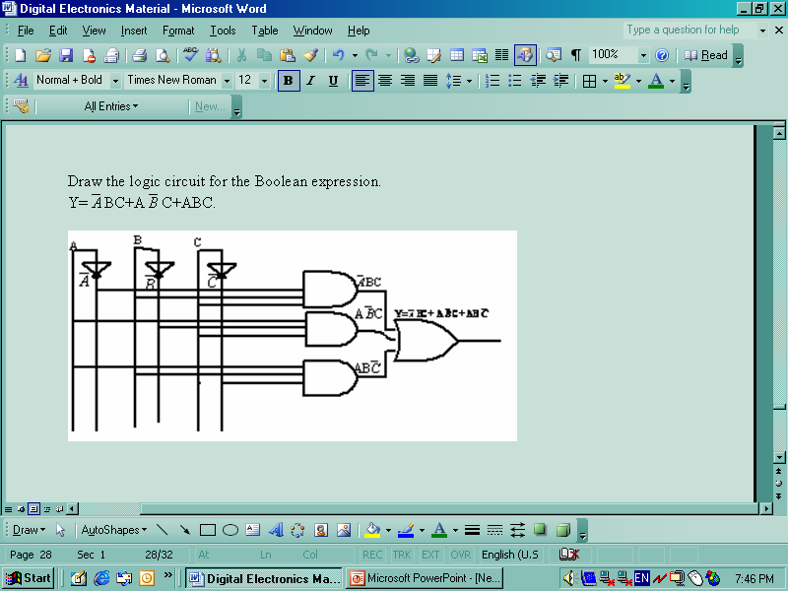
Department of Electronics and Communication Engineering,
Manipal Institute of Technology, Manipal, INDIA

Slide 55
Digital Circuits
Types of Digital Circuits:
Basically digital circuits can be classified into two types.
Sequential Digital Circuits: The logic circuits whose output at any instant of time depend not only on the present input but also on the past outputs are called Sequential Circuits.
In sequential circuits, the output signals are fedback to the input. Thus, an output signal is a function of present input signals and a sequences of the past input signal. i.e. the output signals.
Combinational Digital Circuits: The logic circuits whose output at any instant of time are entirely dependent upon the input signals present at that time are known as combinational digital circuits.
In particular, the output of the combinational circuit doesn’t depend upon any past input or output So that the circuit doesn’t possess any memory. The output signals of combinational circuits are not fedback to any other part of the circuit.
Department of Electronics and Communication Engineering,
Manipal Institute of Technology, Manipal, INDIA

Slide 56
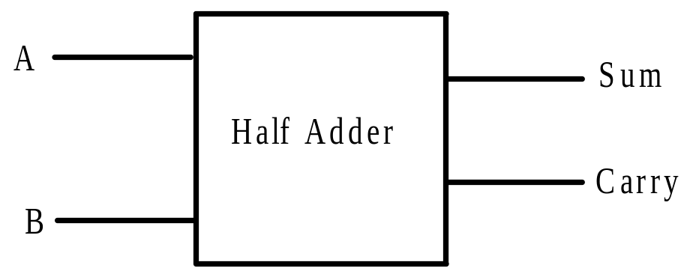
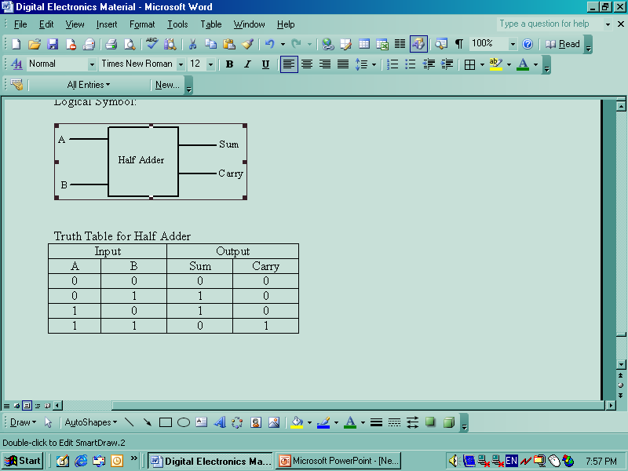
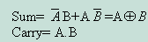
Half Adder: A combinational circuit which performs the arithmetic addition of two binary digits is called Half Adder. In the half adder circuit, there are two inputs, one is addend and augend and two outputs are Sum and Carry.
Department of Electronics and Communication Engineering,
Manipal Institute of Technology, Manipal, INDIA

Slide 57
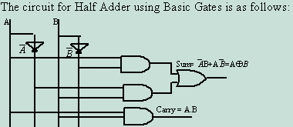
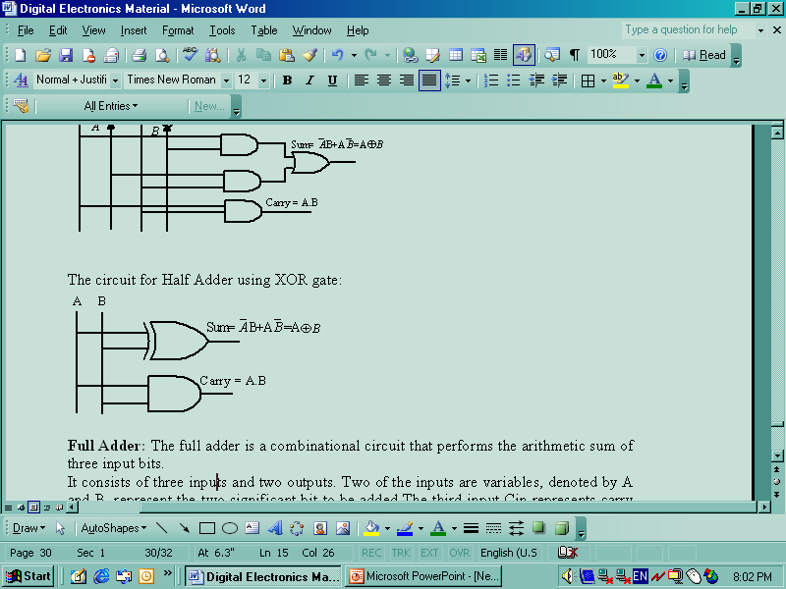
Department of Electronics and Communication Engineering,
Manipal Institute of Technology, Manipal, INDIA

Slide 58
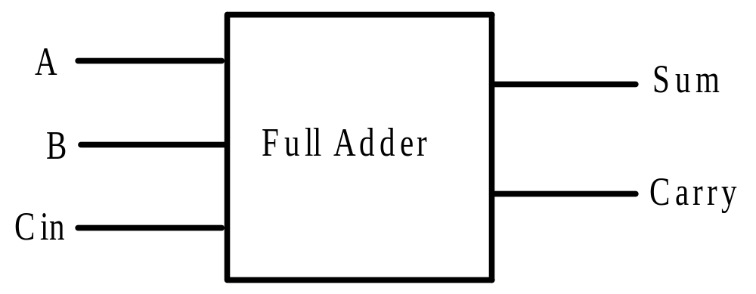
Full Adder: The full adder is a combinational circuit that performs the arithmetic sum of three input bits.
It consists of three inputs and two outputs. Two of the inputs are variables, denoted by A and B, represent the two significant bit to be added The third input Cin represents carry form the previous lower significant position.
Department of Electronics and Communication Engineering,
Manipal Institute of Technology, Manipal, INDIA

Slide 59
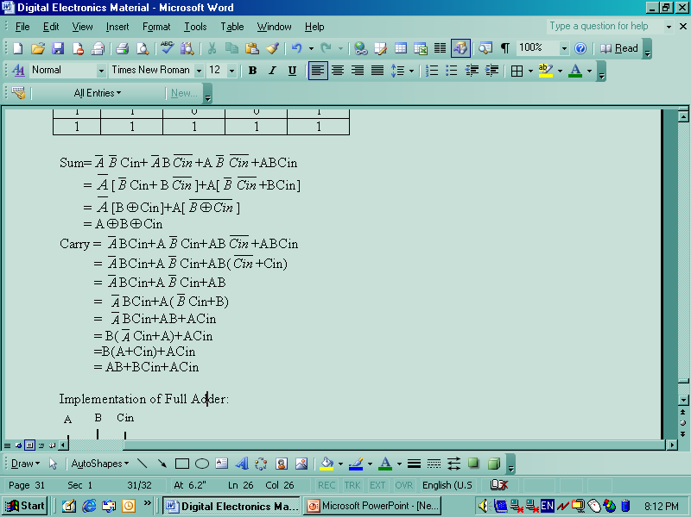
Truth Table for Full Adder
Input |  |  | Output
A | B | Cin | Sum | Carry
0 | 0 | 0 | 0 | 0
0 | 0 | 1 | 1 | 0
0 | 1 | 0 | 1 | 0
0 | 1 | 1 | 0 | 1
1 | 0 | 0 | 1 | 0
1 | 0 | 1 | 0 | 1
1 | 1 | 0 | 0 | 1
1 | 1 | 1 | 1 | 1
Department of Electronics and Communication Engineering,
Manipal Institute of Technology, Manipal, INDIA

Slide 60
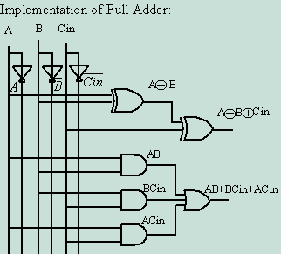
Department of Electronics and Communication Engineering,
Manipal Institute of Technology, Manipal, INDIA

Slide 61
END
Department of Electronics and Communication Engineering,
Manipal Institute of Technology, Manipal, INDIA

